Slide 1
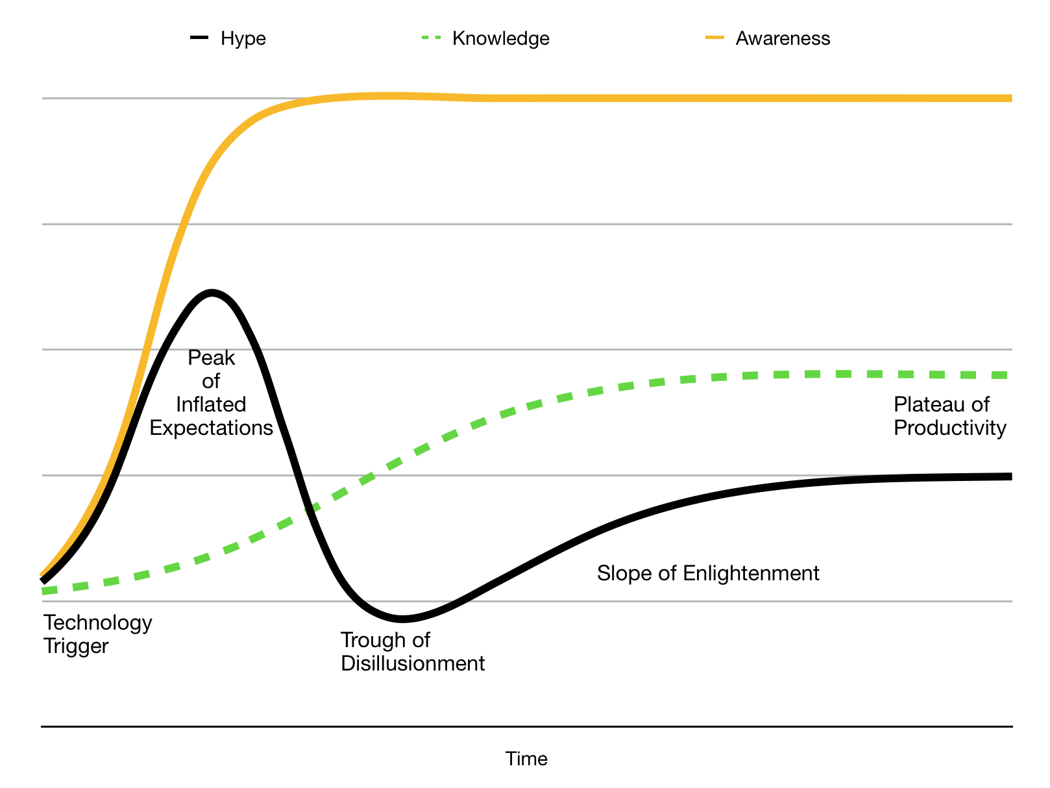
Notes:
So, maybe what Risk-First is, is that I’m now sliding back down that Hype Cycle curve, into the “Trough of Disillusionment”, and I’m trying to figure out what’s useful and what’s not, in the Agile world.
Because the idea came a couple of years ago when I was on a project using Scrum:

Slide 2
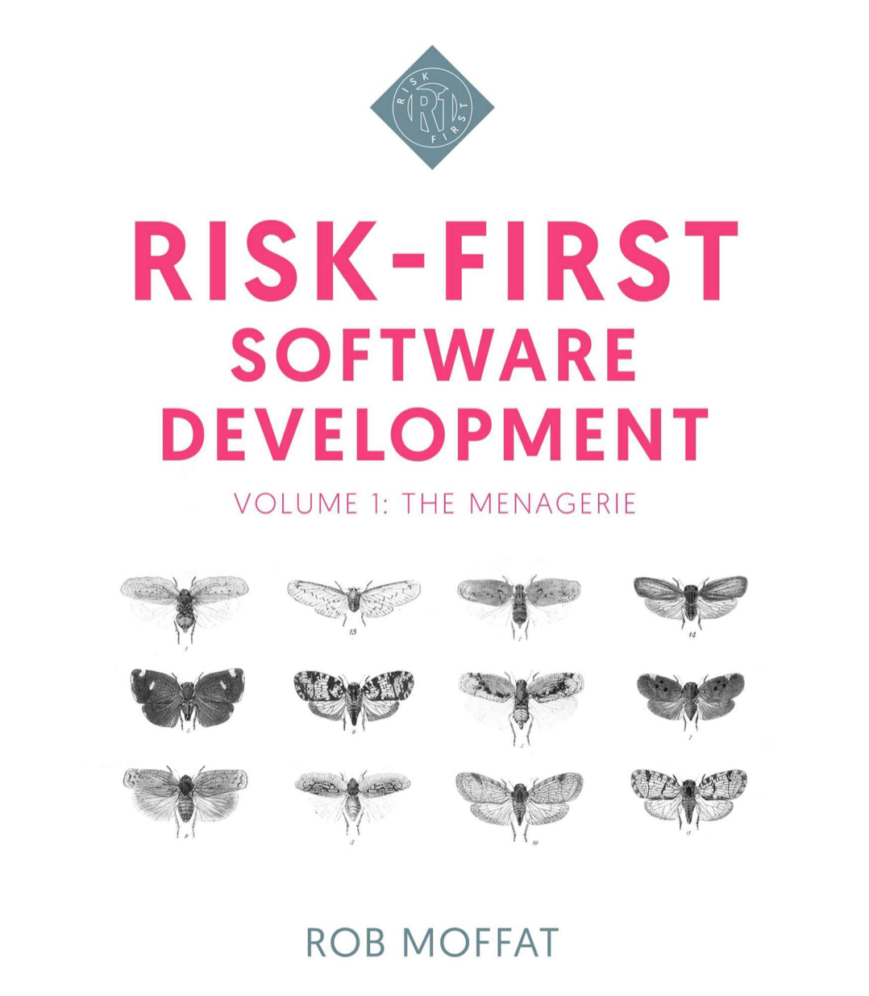
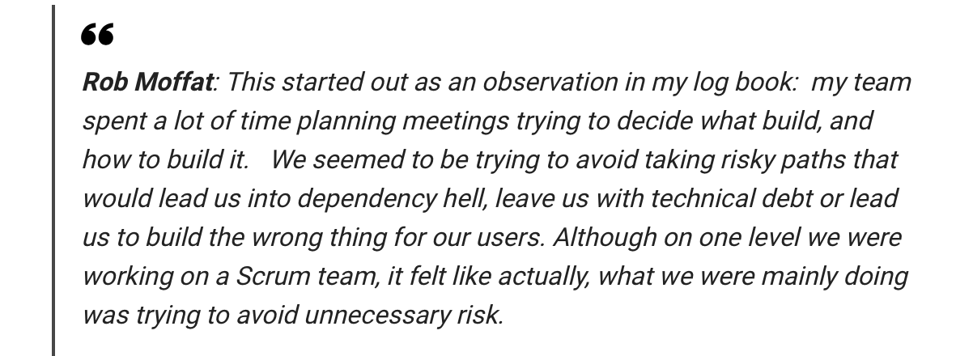
Notes:
—-
So, Risk-First is like a reaction to the Agile Hype-Cycle, applying agile wherever we can.
But there’s another problem nowadays, which is the changing nature of agile.

Slide 3
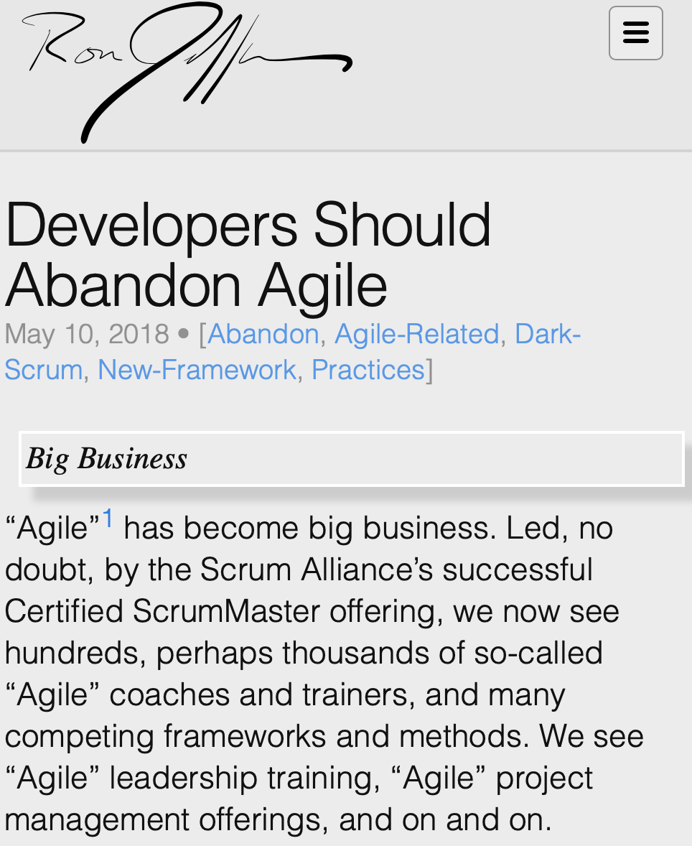
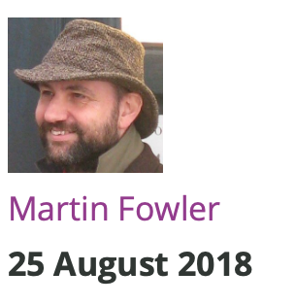
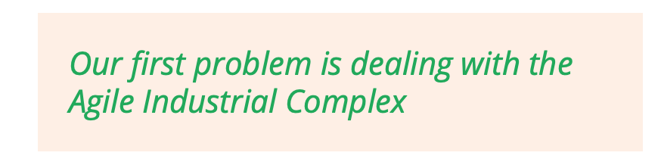
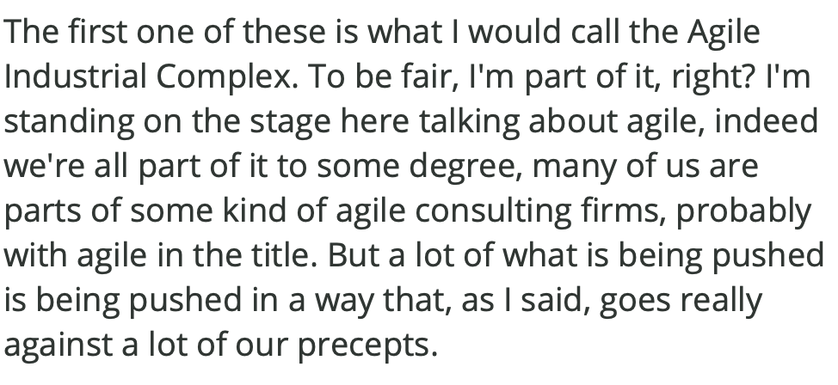
Notes:
There’s a movement now called post-agile, which you can read about on-line.
And here are two examples. On the left, Ron Jeffries, one of the original founders of the agile manifesto.
—
On the right, Martin Fowler, also having a problem with “The Agile Industrial Complex”.
Agile is big business. It’s not just a set of principles now, it’s an industry that wants to sell you training courses, books, accreditation.
These guys are kind of mourning that change.
You Either Die A Hero, Or You Live Long Enough To See Yourself Become The Villain

Slide 4
Notes:
When Kent Beck and Ron Jeffries and Martin Fowler got together to write the agile manifesto, the software landscape was very different than today.
JUnit was a really early open-source library! You could use Tomcat or Apache… or, maybe that was about it.
The landscape has changed.

Slide 5
Notes:
Working in IT is really interesting. Every day is Christmas Eve. There are always new technologies to play with, new ideas to look at new practices to try. This is one of the reasons why it’s such a fun, crazy career to work in.
But, people get carried away with things, as we’ve seen in the hype-cycle.
It’s easy to get caught up in hype.
Blockchain,
AI,
Big Data.

Slide 6
Notes:
What’s getting harder and harder now, is figuring out which tools to use. Not just methodologies, or practices, like we’ve looked at today, but tools of all kinds.
Because there are so many languages, so many libraries. A lot of them are really good.
It’s easy for me to stand here and say: use the libraries or tools or languages that help you address the most risk. This seems like the underlying physics of software development, agile being one way of doing that.
But what’s a much harder problem now is curation. How do I figure out which tool or library to use? How do I know it’ll solve my problems?

Slide 7
Notes:
Who’s seen this game?
This is some screenshots from a game you can play on the internet called “Pokemon or Big Data”. It’s literally poking fun at this exact problem I’m talking about.
You have to decide whether the name of something, like “Vulpix” is the name of a piece of Big Data software, or a Pokemon. My son Jacob turned out to be really good at this because he’s obsessed with Pokemon. Anyway.
So at the moment, we have maybe a few million developers on the internet. I’m guessing. What happens when we have a few hundred million, or a few billion, as we might in 10 years time.
How do I go the right way? How do I choose the right thing to use?
For me, this is a big, and growing risk, and I think this is something that we’re going to need to address over the next 20 years.

Slide 8
Your Ideas
riskfirst.org
Notes:
Ok, enough from me. Let’s hear what you think.

